Slide 1
A Swedish Handbook in Speech-to-text Interpreting
Ulf Norberg, Stockholm University
Presentation at the VDNR Seminar, 24 September 2021

Slide 2
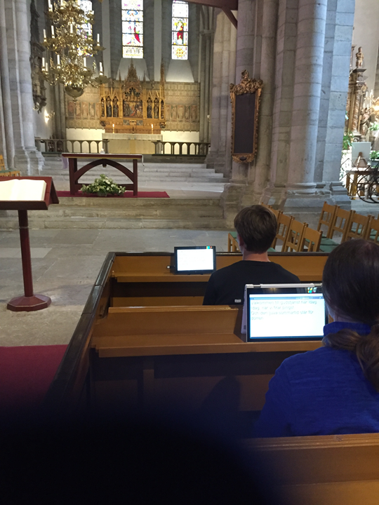
Speech-to-text (STT) interpreter
Swedish: skrivtolk
Danish, Norwegian: skrivetolk
German: Schriftdolmetscher
Spanish: estonotipista, textare
In UK: speech-to-text reporter
In USA: speech-to-text provider, transcriber

Slide 3
Existing documentation on STTI
Some dissertations (e.g., Judith Platter in Austria)
A number of scientific papers and research reports
Hardly any teaching materials, no handbooks
Much less is written about STTI, than about signed language interpreting, conference interpreting, public service interpreting

Slide 4
The sister discipline of STTI: Live subtitling
Much bigger scholarly interest, more established field in the realm of Translation Studies
Part of the field of Audiovisual Translation Studies
By the same methods as STTI: qwerty keyboard, veyboard/Velotype, stenotype, respeaking

Slide 5
Aim of our book
To point at the complexity of STTI
To create a teaching material for STTI training programs, as well as for courses for active STT interpreters
To introduce and discuss research on STTI in Swedish
To describe STTI by comparing with research results concerning other forms of interpreting (signed language interpreting, conference interpreting, public service interpreting)

Slide 6
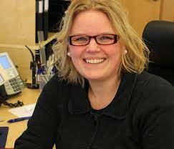
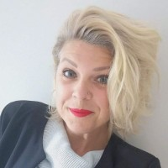
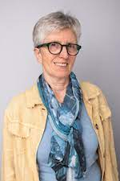
Editors
Ulf Norberg, Associate Professor in Translation and Interpreting, Stockholm University
Ursula Stachl-Peier, Associate Professor in Translation and Interpreting, Graz University, Austria
Maria Laurin, Head of the only Swedish STTI training program, Södertörns folkhögskola, Stockholm
Jenny Therén, STT interpreter, Göteborg
Victoria Öjefors Quinn, STT interpreter, Gotland

Slide 7
Contents
13 chapters, with different lengths
Final section with ”Voices from society”, short texts written by STT users, STT interpreters and different other stakeholders. At the very end, we are happy to have got a very eloquent text by the chairman of the Swedish organisation for hard-of-hearing persons (Hörselskadades Riksförbund), Mattias Lundekvam.
Drawn illustrations by Lena Bolmskog (some appearing in this presentation)
Photos, word list

Slide 8
The chapters
1. Prologue
2. The history of STTI in Sweden
3. The STT interpreter program at Södertörns folkhögskola, Stockholm
4. STTI from a Translation Studies perspective – a research overview
5. The oral vs. written modalities of language, with regard to STTI (co-author: Liisa Tiittula, Helsinki)
6. Speech, text and signed language – STTI in relation to signed language interpreting

Slide 9
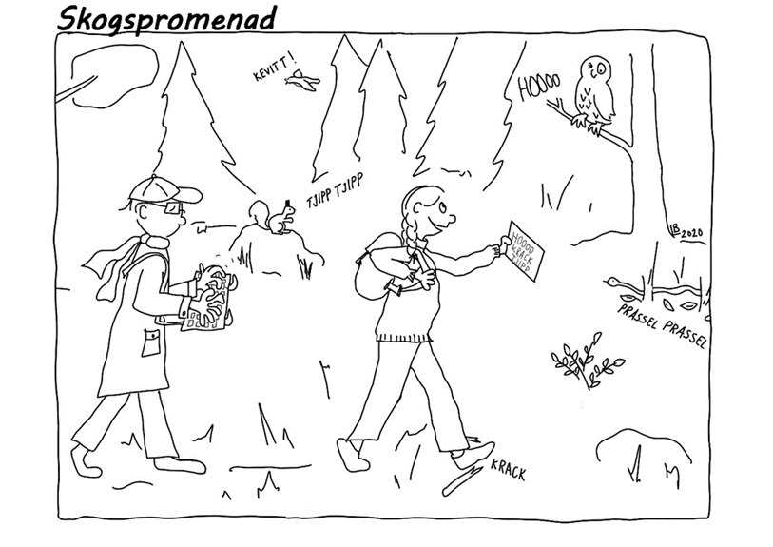
7. Interpreting of monologues
8. Interpreting in conversation situations
9. Interpreting ethics of STTI
10. STTI on distance
11. Equipment for STTI
12. Preparations, work with abbreviations, co-operation
13. Current trends in Swedish STTI and future development

Slide 10
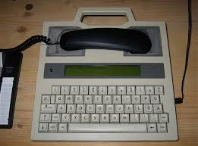
Chapter 2: The history of STTI in Sweden
Four themes and their development:
Regulation
Technical equipment
Training
Professional role

Slide 11
Chapter 12: Preparation, work with abbreviations, co-operation
Focus of the chapter on the work with abbreviations
No standardized, national abbreviation system exists in Sweden
Different principles for abbreviations
Criteria for the creation of abbreviations: easy to remember, easy to write, reducing the number of keystrokes at most, not being coincident with existing words

Slide 12
Chapter 13: Current trends in Swedish STTI and future development
We identify four trends:
STTI on distance during the Corona crisis: pros and cons
New expectations by users, new user groups
A broader professional role for STT interpreters, when text production enters new fields
Technological development: respeaking, automatic speech recognition (ASR)

Slide 13
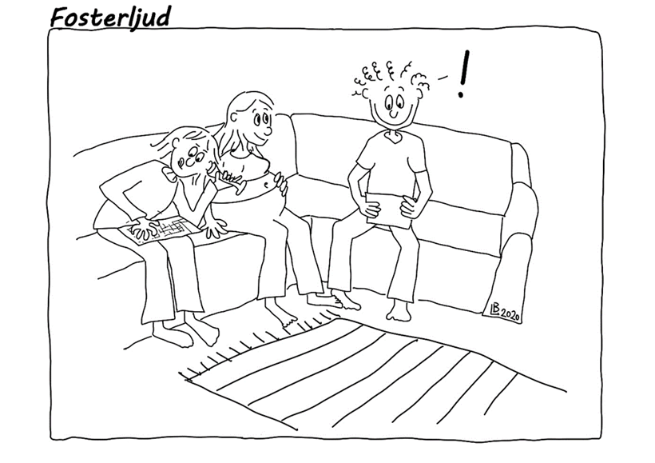
Any peer reviewing of the chapters?
Colleagues at the Institute for Interpreting and Translation Studies, Stockholm University, namely Jan Pedersen, Catrin Thorin, Cecilia Wadensjö, Ingrid Almqvist and some more, have gone through the chapters.

Slide 14
The book is not public yet, but will hopefully be before the end of this year
Publisher is Myndigheten för tillgängliga medier (Eng. Swedish Agency for Accessible Media)
Contact person: Björn Westling

Slide 15
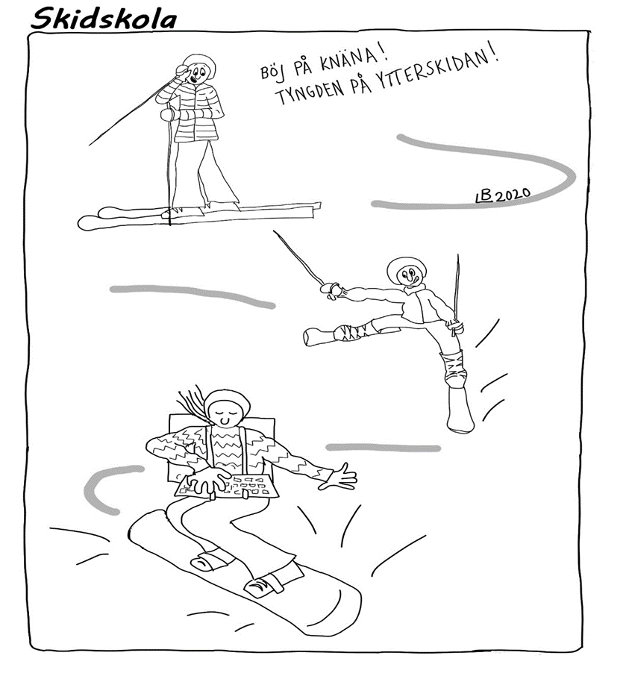
Thank you for your attention!
I am very grateful for all kinds of comments, please write to:
ulf.norberg@su.se

